Slide 1
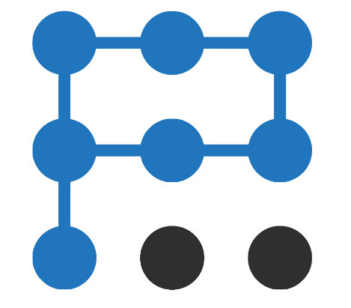
PARTA Networks
Software Defined Everything

Slide 2
Targitas SD-WAN Implementation
SOFTWARE DEFINED EVERYTHING
Assessment and Planning
Identify the organization's networking needs, application requirements, and business goals.
Evaluate existing network infrastructure, including WAN links, routers, and firewalls.
Analyze traffic patterns and bandwidth usage for different applications.
Define key performance indicators (KPIs) for the SD-WAN solution.

Slide 3
Targitas SD-WAN Implementation
SOFTWARE DEFINED EVERYTHING
Architecture Design
Determine the SD-WAN deployment model: on-premises, cloud-based, or hybrid.
Select SD-WAN vendor(s) based on features, scalability, security, and compatibility.
Design the logical and physical network topology, including branch offices, data centers, and cloud connections.
Decide on the number and type of SD-WAN devices (physical/virtual appliances) required.

Slide 4
Targitas SD-WAN Implementation
SOFTWARE DEFINED EVERYTHING
Connectivity and Transport
Choose WAN transport options: MPLS, broadband, LTE, or a combination.
Define link characteristics and bandwidth allocation for each application type.
Consider redundancy and failover mechanisms for ensuring network reliability.

Slide 5
Targitas SD-WAN Implementation
SOFTWARE DEFINED EVERYTHING
Security Considerations
Implement encryption for data in transit using techniques like WireGuard, IPsec.
Integrate security services such as next-generation firewalls (NGFW) and intrusion detection/prevention systems (IDS/IPS).
Set up segmentation to isolate sensitive traffic from regular traffic.

Slide 6
Targitas SD-WAN Implementation
SOFTWARE DEFINED EVERYTHING
Traffic Management
Configure application-aware routing based on application performance requirements.
Implement Quality of Service (QoS) policies to prioritize critical applications.
Utilize dynamic path selection to intelligently route traffic based on real-time link conditions.

Slide 7
Targitas SD-WAN Implementation
SOFTWARE DEFINED EVERYTHING
Traffic Management
Configure application-aware routing based on application performance requirements.
Implement Quality of Service (QoS) policies to prioritize critical applications.
Utilize dynamic path selection to intelligently route traffic based on real-time link conditions.

Slide 8
Targitas SD-WAN Implementation
SOFTWARE DEFINED EVERYTHING
Centralized Management
Set up a centralized management platform for orchestrating and configuring SD-WAN devices.
Implement a single-pane-of-glass dashboard for monitoring network performance, traffic patterns, and security events.
Enable policy-based configuration changes to ensure consistent network policies across all branches.

Slide 9
Targitas SD-WAN Implementation
SOFTWARE DEFINED EVERYTHING
Application Visibility and Control
Implement deep packet inspection (DPI) to gain insights into application behavior and performance.
Use application steering to direct traffic based on user-defined policies and real-time conditions.

Slide 10
Targitas SD-WAN Implementation
SOFTWARE DEFINED EVERYTHING
Monitoring and Analytics
Implement network monitoring tools to track KPIs and network health.
Collect and analyze data on application performance, bandwidth utilization, and user experience.
Utilize analytics to identify trends, troubleshoot issues, and optimize network performance.

Slide 11
Targitas SD-WAN Implementation
SOFTWARE DEFINED EVERYTHING
Testing and Rollout
Conduct thorough testing in a controlled environment before full deployment.
Perform a phased rollout, starting with a subset of branches or locations.
Monitor the network closely during the initial rollout to identify any unexpected issues.

Slide 12
Targitas SD-WAN Implementation
SOFTWARE DEFINED EVERYTHING
Training and Support
Provide training to IT staff on managing and troubleshooting the SD-WAN solution.
Establish a support mechanism for addressing technical issues, updates, and maintenance.

Slide 13
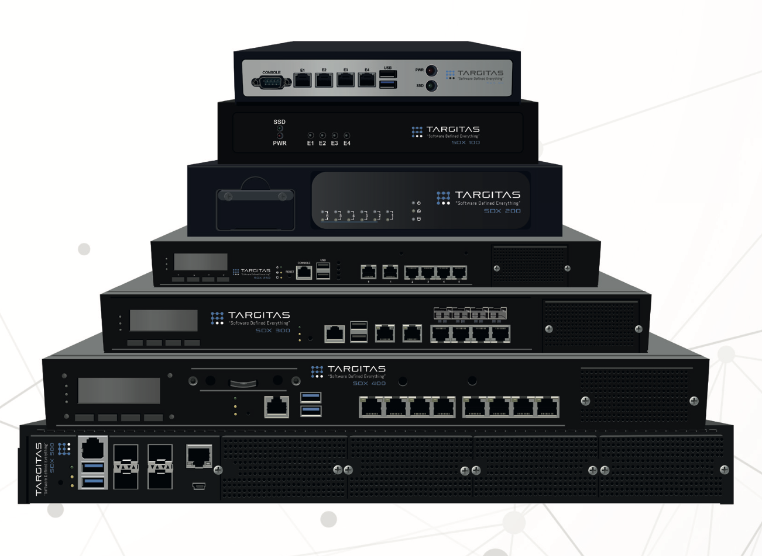
Targitas Modeller
SOFTWARE DEFINED EVERYTHING
SDX 80
Entry Level
SDX 250
Mid Level
SDX 100
SDX 300
Entry Level
Mid Level
SDX 400
Advanced Level
SDX 200
Entry Level
SDX 500
Advanced Level
SDX 240
SDX VM
Mid Level
It is available in the
DMO Catalog.

Slide 14
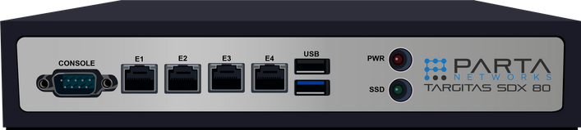
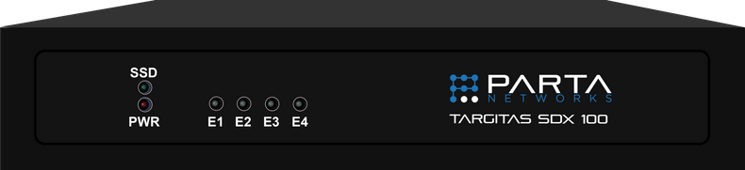
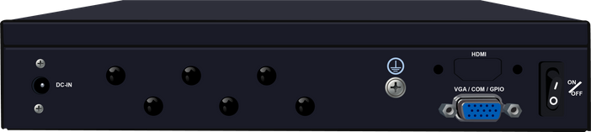
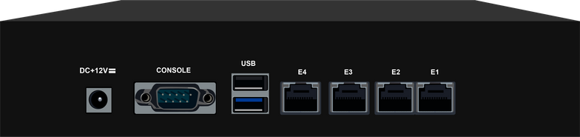

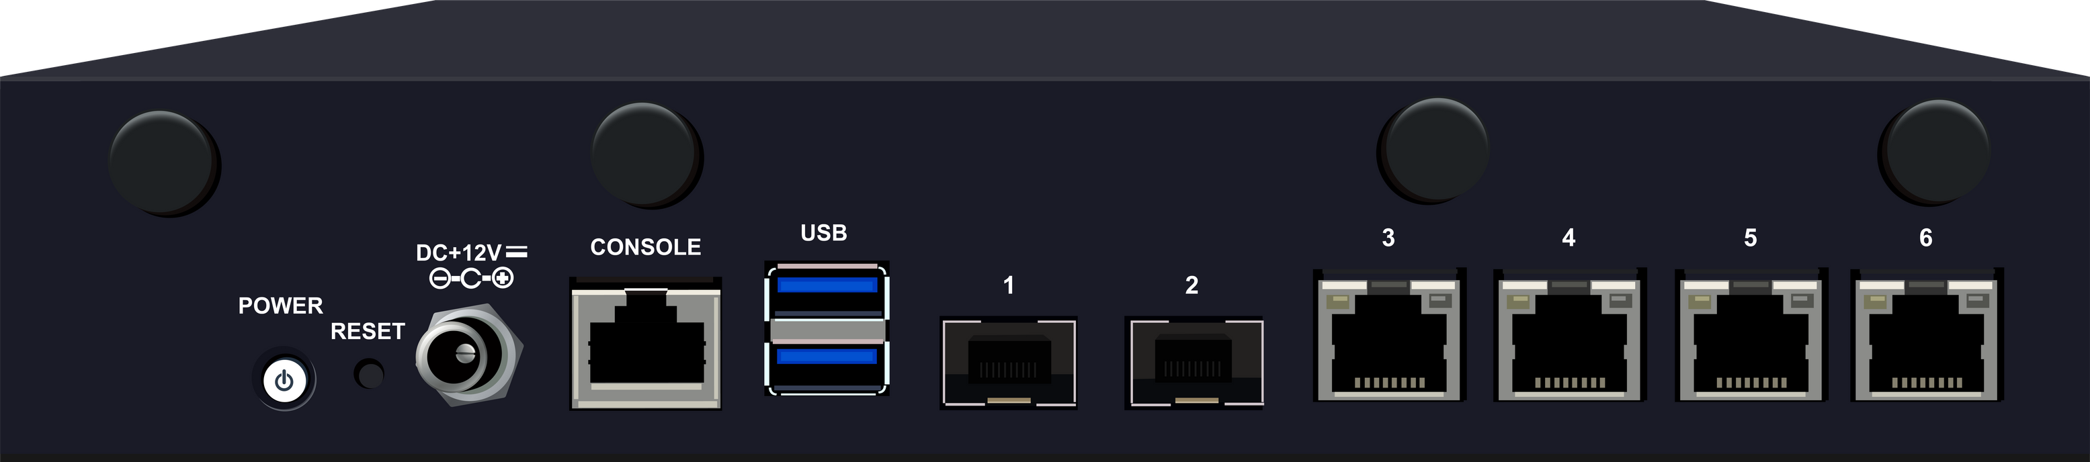
Targitas Modeller
SOFTWARE DEFINED EVERYTHING
SDX 80
SDX 100
SDX 200

Slide 15
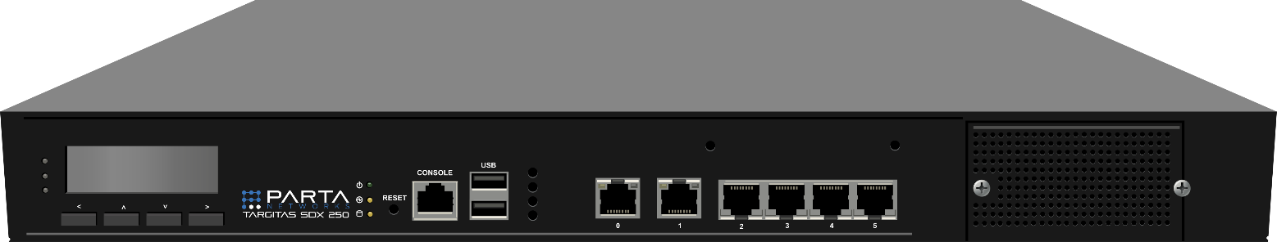

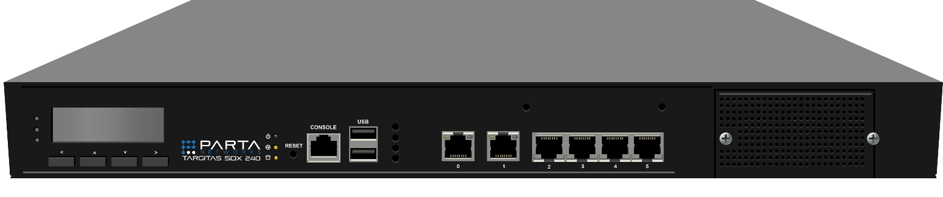
Targitas Modeller
SOFTWARE DEFINED EVERYTHING
SDX 250
SDX 240

Slide 16

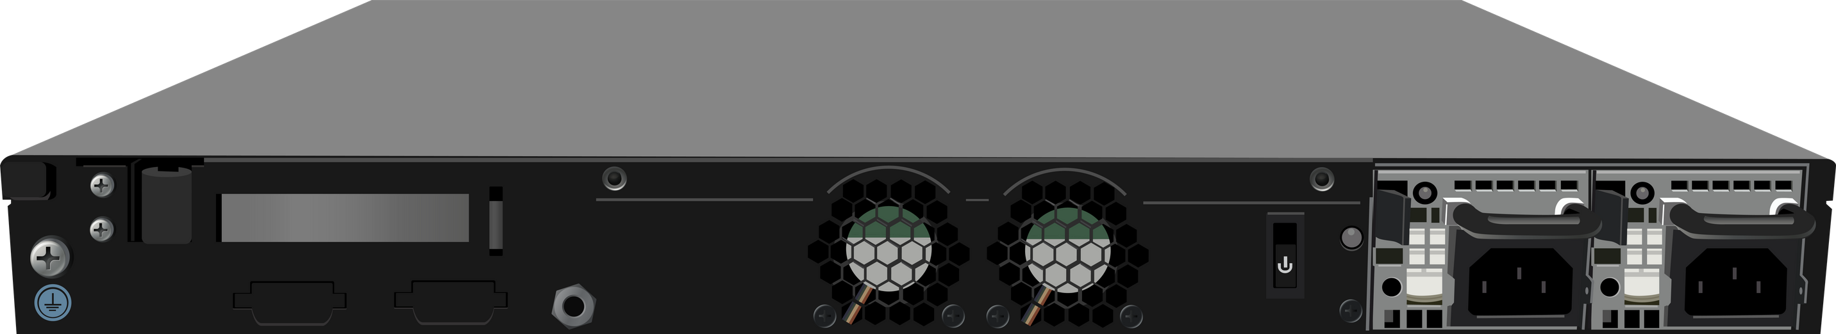
Targitas Modeller
SOFTWARE DEFINED EVERYTHING
SDX 300

Slide 17

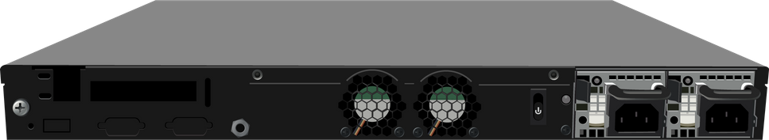
Targitas Modeller
SOFTWARE DEFINED EVERYTHING
SDX 400

Slide 18
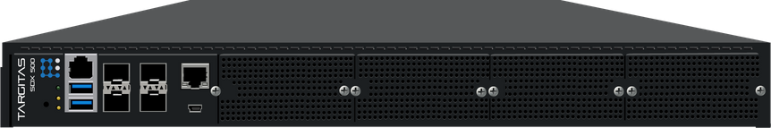
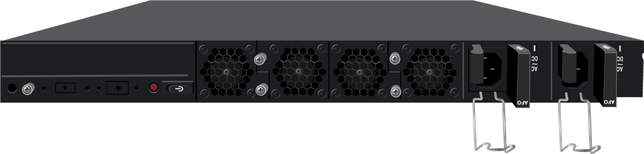
Targitas Modeller
SOFTWARE DEFINED EVERYTHING
SDX 500

Slide 19
THANKS FOR YOUR INTEREST
Parta Networks| Network and Network Security
bilgi@parta.com.tr

